Slide 1
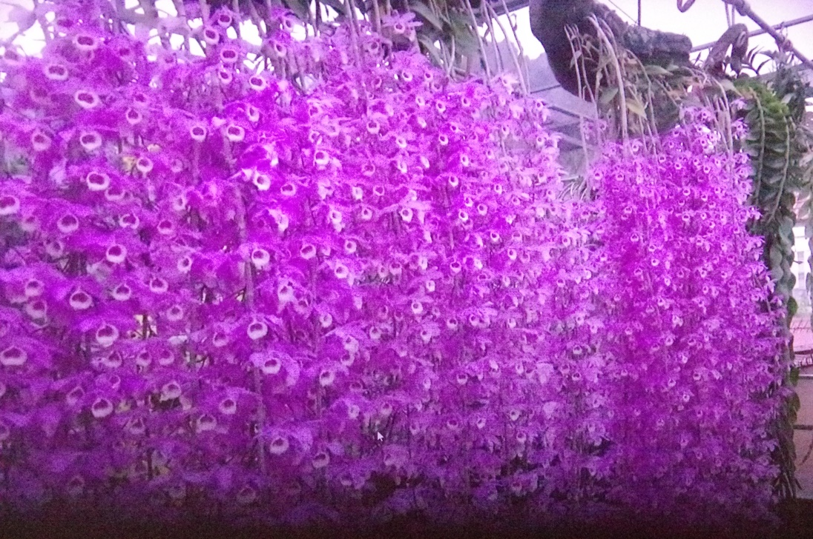
Deciduous Dendrobium Orchids
By Gary Hodder copyright on photographs

Slide 2
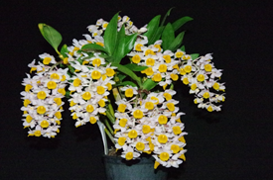
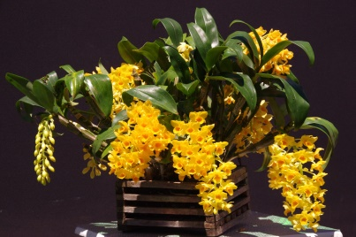
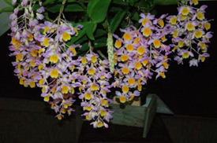
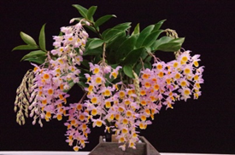
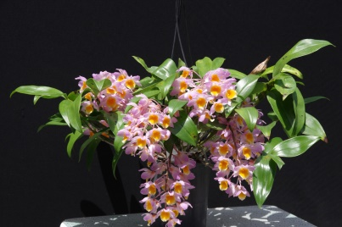
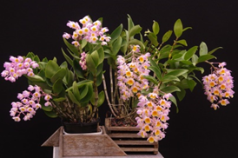
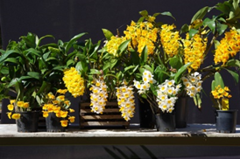
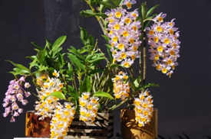
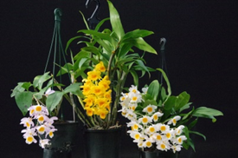
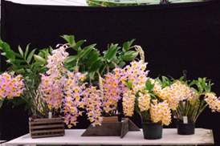
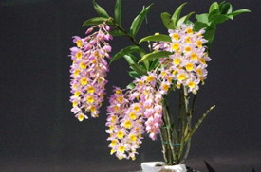
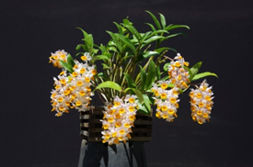
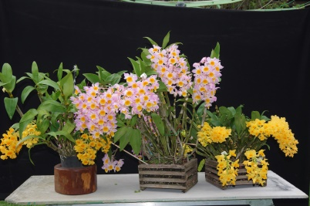
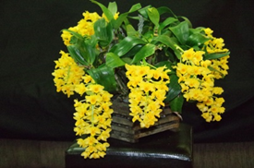
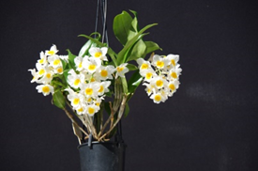
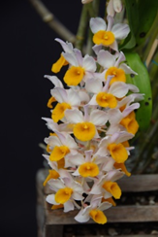
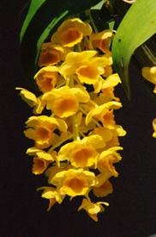
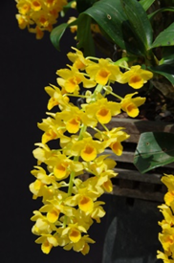
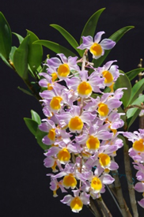
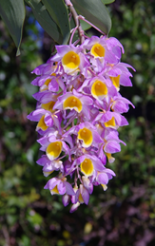
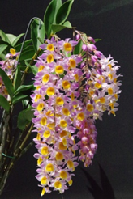
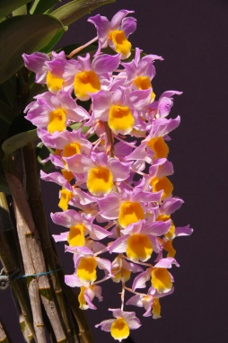
Gary Hodder’s South East Asian Dendrobiums 2021

Slide 3
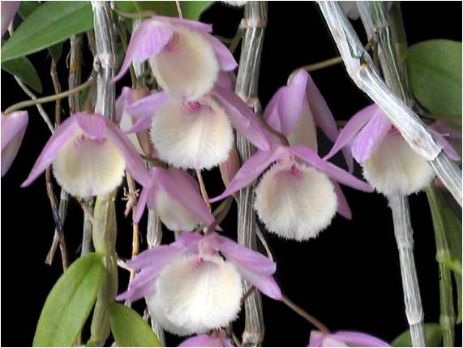
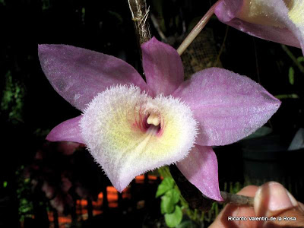
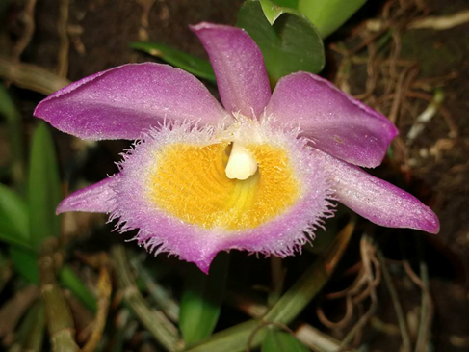
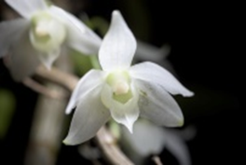
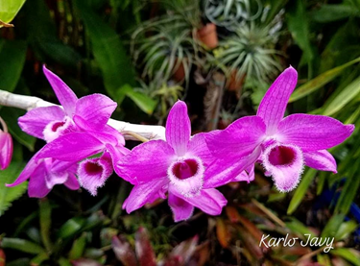
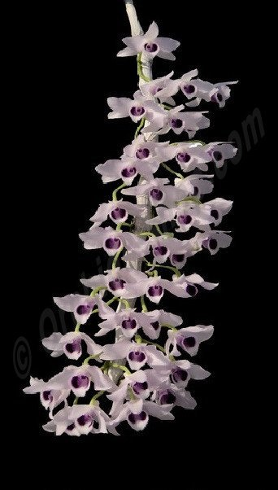
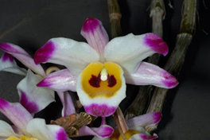
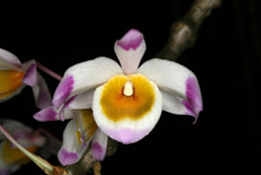
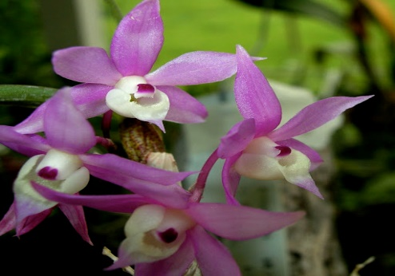
My Deciduous Dendrobium Orchids

Slide 4
Location of Dendrobium Orchid Species habitat in the world

Slide 5
To grow Deciduous Dendrobiums:- They require maximum light. Shade in hottest part of bright sunny summer days. Plenty of heat, air circulation, water and humidity in growth phase. Up to 2 month winter rest period indicated by:- a) no production of new leaves. b) most canes leafless. In Sydney grow under a solid roof in winter to control the water so as to keep them dry.

Slide 6
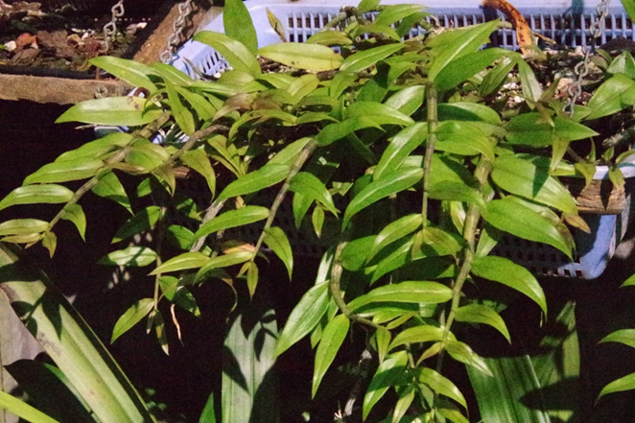
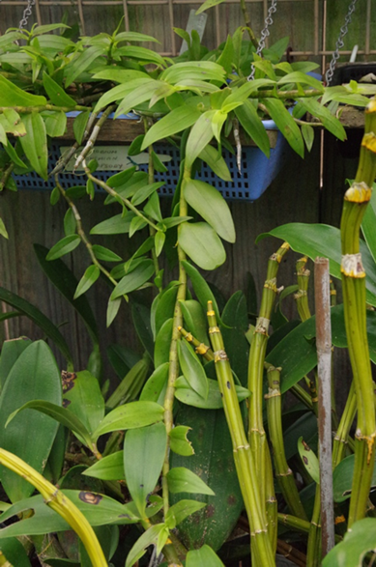
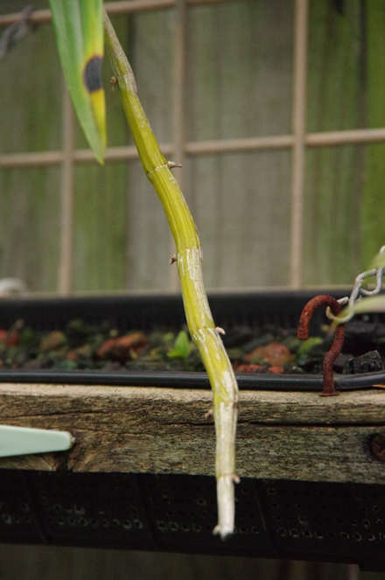
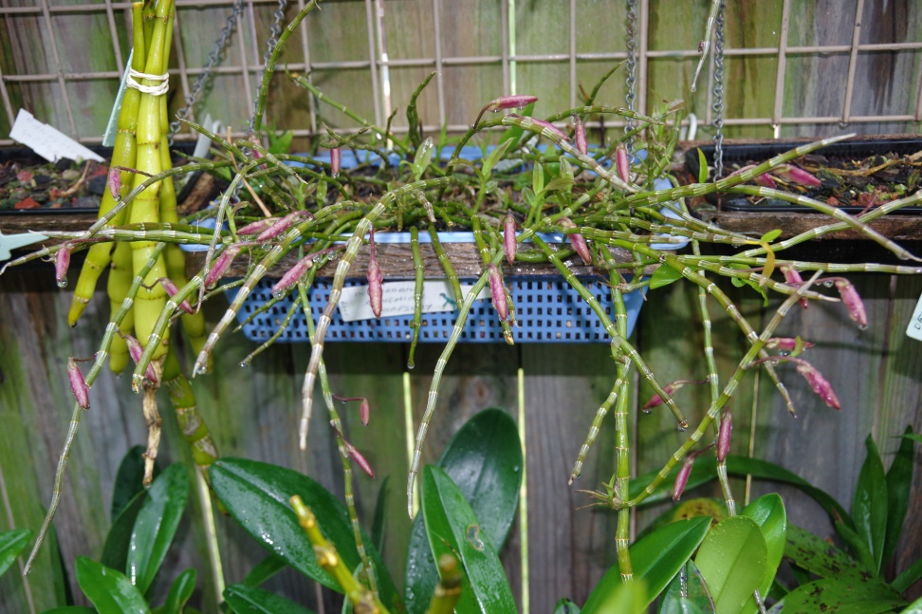

Slide 7
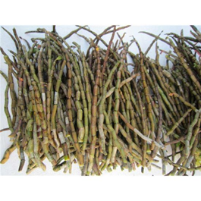
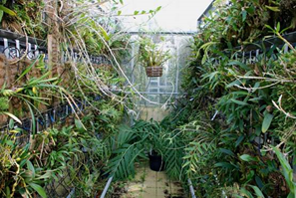
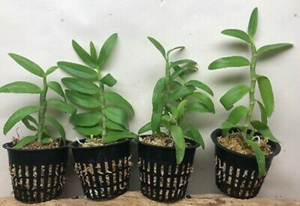
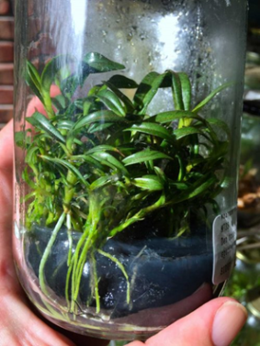
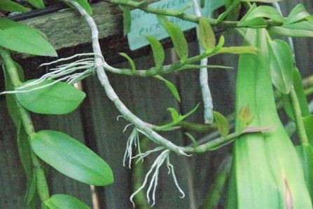
There are many ways to obtain Deciduous Dendrobium Orchid Plants.
In the Asian Countries they grow the young plants in the nursery and sell them or take them to the markets for sale.
In Australia the only way to get new plants is by purchasing Flasks, Local plant sales, divisions or Kiekies.

Slide 8
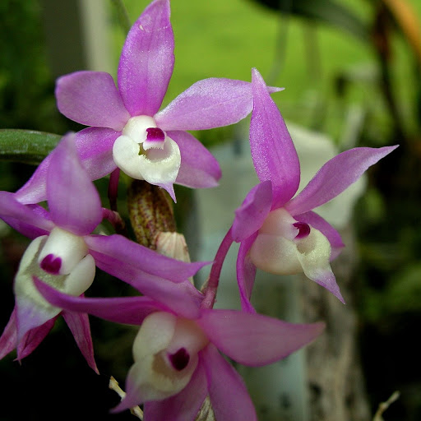
Deciduous Dendrobium Orchids
Dendrobium aduncum
Dendrobium aduncum is a species. It is native to southern China, the eastern Himalayas, and northern Indochina.
Dendrobium aphyllum
Dendrobium aphyllum, commonly known as the hooded orchid is a species native to Bangladesh, southern China, the eastern Himalayas, and Indochina.

Slide 9
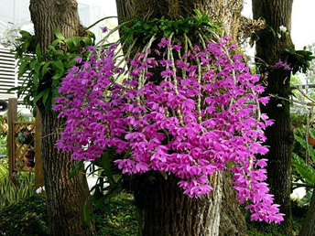
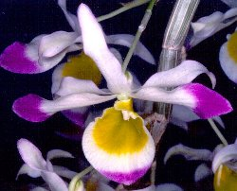
Deciduous Dendrobium Orchids
Dendrobium anosmum
Dendrobium anosmum (also known as superbum) is a species. It is widespread across Southeast Asia from Sri Lanka to New Guinea, including Indochina, Indonesia and the Philippines.
Dendrobium crystallinum
Dendrobium crystallinum is a species. It is native to Southeast Asia, Hainan and Yunnan in China, and Manipur in India.

Slide 10
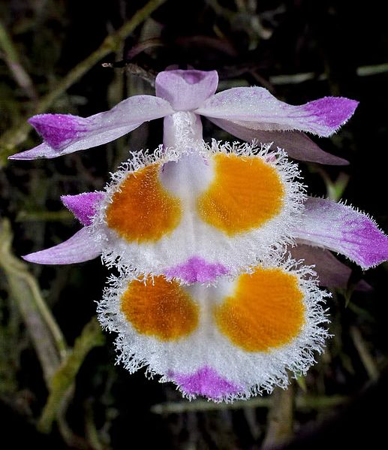
Deciduous Dendrobium Orchids
Dendrobium devonianum Dendrobium devonianum is found in the Chinese Himalayas, Bhutan, , Thailand Myanmar, and, Laos, Vietnam and the Indian state of Assam. It is a mountain species found in trees at an altitude of 500-2000 metres.
Dendrobium “Bohemian Rhapsody”
Dendrobium Bohemian Rhapsody is a hybrid originated by David Banks in 1995. It is a cross between Den. loddigesii and Den. aphyllum. It is considered a "primary hybrid" because it is a cross between two species.

Slide 11
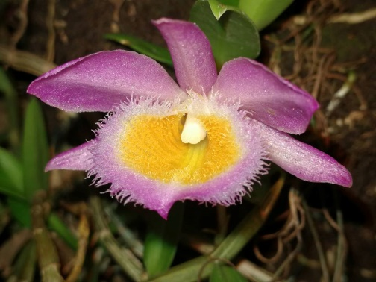
Deciduous Dendrobium Orchids
Dendrobium loddigesii
Dendrobium loddigesii is a warm to cold growing orchid from Laos, Vietnam, and China. It is found in humid, mossy, mixed and coniferous forests at elevations of 1000 to 1500 metres.
Dendrobium parishii
Dendrobium parishii is a species native to Asia. It is found in the Eastern Himalayas, in southwest China, Northern and Eastern Thailand, Laos, Vietnam to the Provinces of Yunnan and Gweizhou growing in deciduous forests at heights of 250-1700 metres.

Slide 12
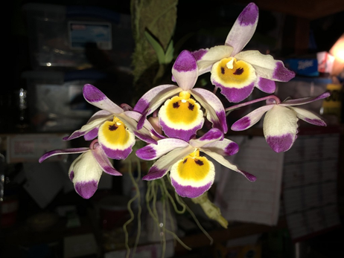
Deciduous Dendrobium Orchids
Dendrobium pierardi
(also known as D. aphyllum, D. cucullatum) commonly known as the hooded orchid, it is a species native to Bangladesh, southern China, the eastern Himalayas, and Indochina
Dendrobium falconeri
Dendrobium falconeri is a species native to southern China, Taiwan, the Eastern Himalayas, North Eastern India and Northern Indochina.

Slide 13
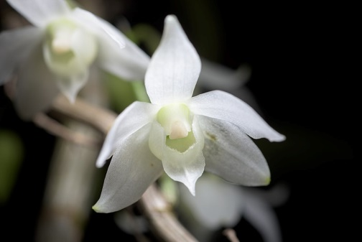
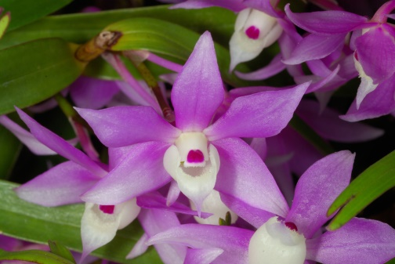
Deciduous Dendrobium Orchids
Dendrobium hercoglossum var. alba
Dendrobium hercoglossum is native to Sumatra, Malaya, Myanmar, Thailand, Laos, Vietnam, China and the Philippines. In China these plants are found in Kwangtung, Hainan and Hong Kong at an altitude of 600-1260 metres.
Dendrobium hercoglossum
Dendrobium hercoglossum as shown is the common form and is from the same areas as the alba.

Slide 14
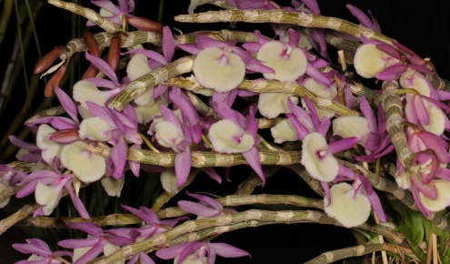
Deciduous Dendrobium Orchids
Dendrobium polyanthum
Dendrobium polyanthum is native to the Himalayan region of northern India, from the Garhwal area near Debra Dum to the Lushai Hills along the border with Myanmar , Thailand, Cambodia, Laos and Vietnam. They are also found on the Andaman islands. These plants usually occur in open forests at heights of 1000-1800 metres.
Dendrobium wardinum
Dendrobium wardianum is widely distributed in Southeast Asia but in isolated areas. In India they grow near Gangtok in Sikkim, in Bhutan on Khasi Hills (Khasia), in Assam and in the Manipur region.

Slide 15
Deciduous Dendrobium Orchids
Dendrobium primulinum
Dendrobium primulinum is widespread in India and south-east Asia. Its habitat stretches from Mussorie in the Garhwal region of northern India, through Nepal, Sikkim and the Lushai Hills region of Northeast India, Chin Hills in Myanmar and Laos.
Dendrobium primulinum laos dark form

Slide 16
Deciduous Dendrobium Orchids
Dendrobium falconeri
Dendrobium falconeri is a species native to Asia. It can be found in southern China (Hunan, Yunnan), Taiwan, the Eastern Himalayas (Bhutan), North Eastern India (Arunachal Pradesh, Assam, and Sikkim), and northern Indochina (Myanmar, Thailand, Vietnam).
Dendrobium pendulum
Dendrobium pendulum is a species. Flowers can be small to large, is a warm to cold growing epiphyte and is occasionally found as a lithophyte in North East India and from the Western Himalayan range to Vietnam.

Slide 17
Festival of food

Slide 18
Some typical examples of well grown Deciduous Dendrobiums

Slide 19
More Deciduous Dendrobiums from Asia

Slide 23
Dendrobium amethystoglossum
Dendrobium amethystoglossum (also called Amythest Colored Dendrobium), is native to northwest part of the island of Luzon (Philippines). They occur in the province of Benguet, where they often grow on mossy, limestone cliffs, at an altitude of about 1,400 metres.
Unlike all others this Dendrobium will take temperatures as low as 6 degrees C

Slide 24
Ways to increase your orchid collection
Purchase new orchids from venders at orchid shows, The Internet or Orchid Nurseries.
Subdivide mature healthy plants.
Remove kiekies from parent plants.
Grow from seed or purchase flasks.

Slide 25
In Asia I would say up to 80% of there orchids are grown by cuttings but in Australia I know few growers that take cuttings. One method they use is once the orchid cane is finished flowering they cut the cane just above potting media surface and the surfaces of both cut sections are coated with Aloe Vera sap. They then hang the cut canes upside down in their orchid area and treat as a growing orchid.

Slide 26
Simple method of increasing your collection for Dendrobiums

Slide 27
The way the Asians increase their orchids
Another method they use is once the orchid has finished flowering they cut the cane and seal both cut surfaces with Aloe Vera sap. They then cut each cane into sections where each section has 3 eyes or nodes. These cut sections are then laid on a bed of coconut fibre and watered with a solution and kept moist.

Slide 28
They then water all the new cuttings with a solution made up from :- one teaspoon MSG half teaspoon honey 200 ml hot water This is then stirred and allowed to cool. Banana peel is then cut into 3cm lengths and placed in a bottle and covered with water then allowed to sit for 1 week. They are then mixed together and sprayed over the orchid.

Slide 29
Banana peels contain lots of nutrients, including potassium, phosphorus, magnesium and calcium. For fertilizer they place Banana peel in the sun and allow then to fully dry until they are totally black and dehydrated. These dried skins are then put through a hammer mill and the powder is placed on top of the potting media about 12mm thick.

Slide 30
Although banana peels have a high concentration of potassium, fresh banana peels should never be used on orchid due to the ethylene gas that is given off which poisons the Orchid and then eventually over a period of time dies.

Slide 31
Singapore Changi Airport

Slide 33
Singapore Changi Airport

Slide 34
Mrs Lori Hodder My wife Mr Graeme Davies Thank you for your attention and interest The End E2
ACKNOWLEDGEMENT I would like to acknowledge the following people as without their help and assistance this presentation would not have been possible

Slide 35
The photographs below show the results of fertilizing. All 4 seedlings are from the same pod and the plants fed in different ways. The plants were all Den speciosum var. speciosum “Dreamtime” crossed with Den speciosum var. speciosum “Heather” AM/ANOS and were obtained from Ross & Ronda at Cedarvale Orchids at the Southern Orchid Spectacular in 2016. The pot on the left was given no fertilizer at all. The next pot was only given Blood and Bone on top of the potting media. Then the 3rd pot was fed with a fertilizer readily available to the general public, mixed with water and sprayed on the plant. The last plant was fed with a specialised commercially available fertilizer, having an N.P.K. 19:2.5:17 plus trace elements but is not available to the general public. This was mixed with water and sprayed on the plant.

