Slide 1
Pests & Diseases Of Orchids
And some suggested treatments

Slide 2
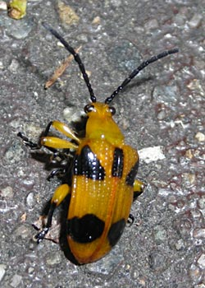
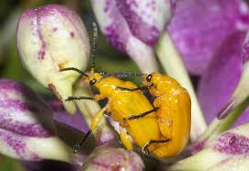
Dendrobium Beetle Not what you want to see on your plants – particularly the last photo! One of the worst insects we find around orchids.

Slide 3
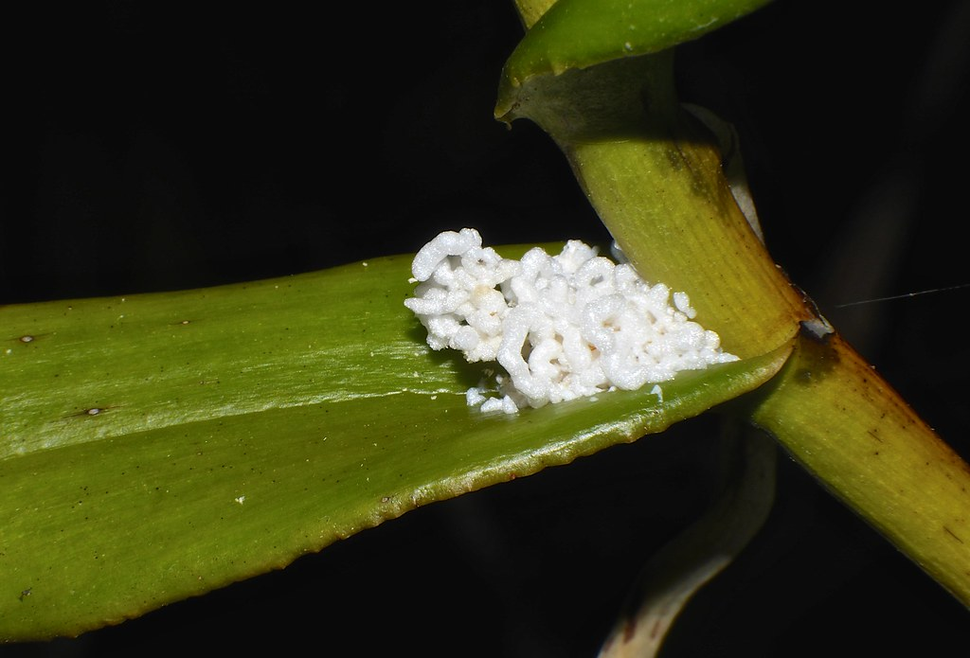
Pupal chamber or egg sack.

Slide 4
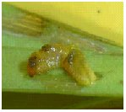
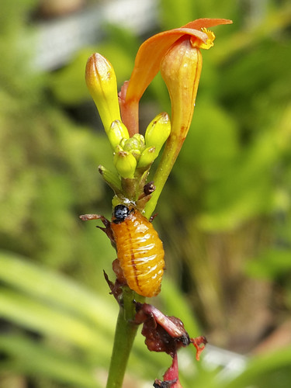
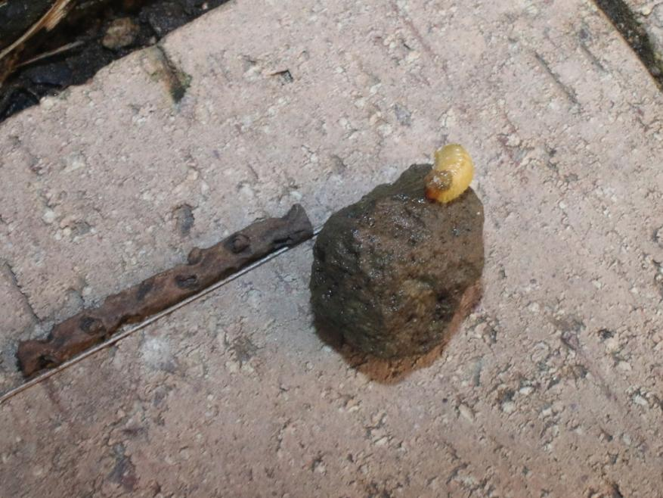
Larvae – they eat out Dendrobium canes at a frightening rate – do not mind eating flowers either. No orchid is impervious to them either.

Slide 5
Typical leaf damage.

Slide 6
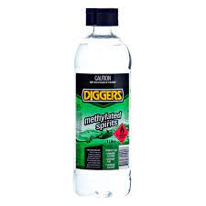
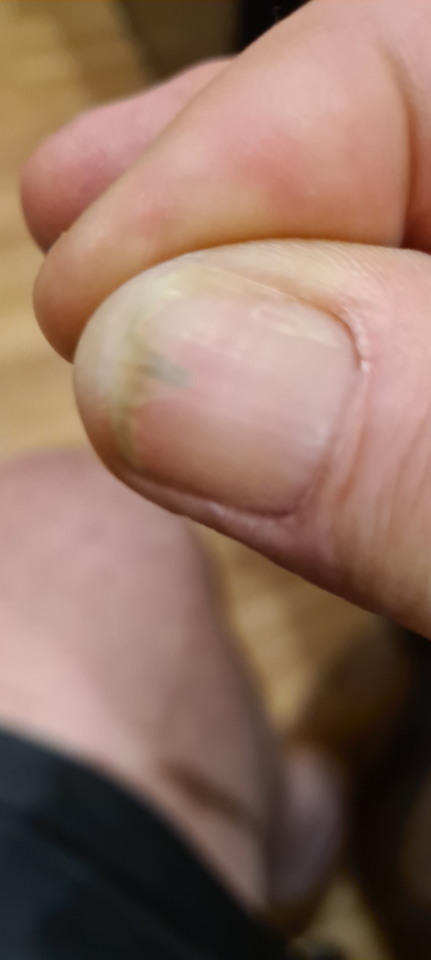
Some cures and effective chemicals to keep them at bay.

Slide 7
The old boot works well so does squish between the fingers. Dropping them in metho in a bottle also works well. Trouble is you have to be there virtually all day to be able to do this effectively. Be careful – if they are disturbed at all they curl up and drop – never to be found again - till they fly back on to your orchid.

Slide 8
Bifenthrin and Carbaryl both work well. Carbaryl needs to be sprayed every 2-3 weeks to be effective. Similar situation with Bifenthrin. Both have a residual effect. Bifenthrin is used for many pests around houses and by pest controllers. A wetter is best to be added to the spray – a proper wetter not dishwashing liquid. Make sure the wetter is not petroleum based. Spreadwell is usually available from Bunnings.

Slide 9
If the grubs get into the canes the only thing that will effectively kill them is a systemic insecticide like Crown or Confidor but it may be too late – it does take time for a systemic insecticide to get into the plant. Best to stop them in the first place.

Slide 10
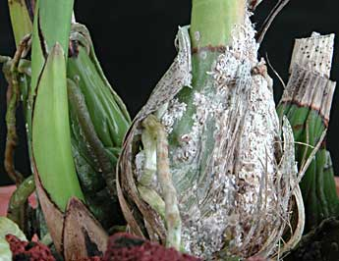
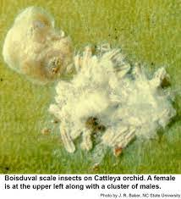
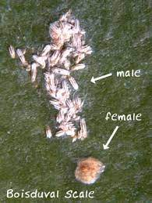
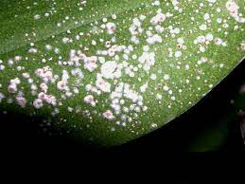
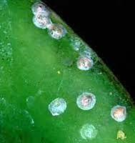
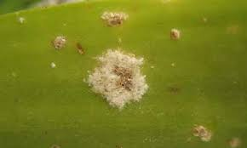
Boisduval Scale & Mealy Bugs

Slide 11
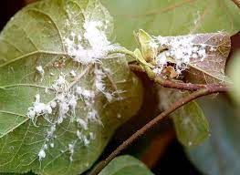
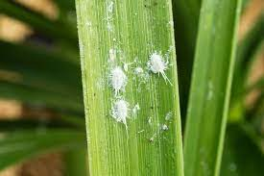
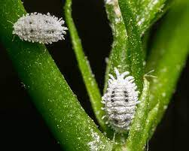
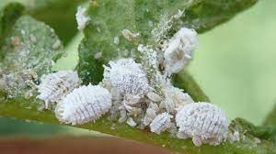

Slide 12
I have basically combined these as people constantly mistake Boisduval Scale for Mealy Bugs – Mealy Bugs are not too bad – Boisduval Scale is possibly the worst insect you can get anywhere near you orchids. If you have Cattleya or Cymbidium in particular it is lying in wait for you. Both of these insects also get into the mix where Eco or non systemic insecticides do not go – systemic is the only way.

Slide 13
Also with Boisduval Scale the life cycle is 50 days – spray every 10 days for 50 days to kill it. Alternate systemic sprays from different groups to avoid resistance building up in the insect population. At one point in the life cycle Boisduval Scale can fly. Get rid of ants – they will transmit it from plant to plant.

Slide 14
Use a good systemic insecticide such as Crown (acetamiprid) if you can afford it. Spectrum (imidacloprid) – a friend of mine is trying Movento 240 SC (spirotetramat) and so far it appears to be an effective alternative for scale, aphids, thrips – in fact all sucking pests. Movento Energy combines two systemic insecticides and looks even better. It combines spirotetramat and imidacloprid – the good thing here is one is a group 4A and the other is a group 23 insecticide so it should reduce the chance of resistance building up in insects.

Slide 15
A wetter is best to be added to the spray – a proper wetter not dishwashing liquid. Make sure the wetter is not petroleum based. Spreadwell is usually available from Bunnings.

Slide 16
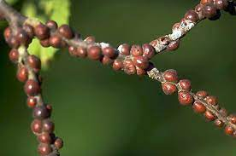
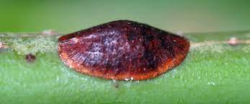
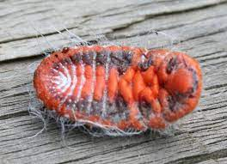
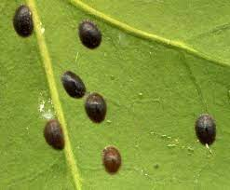
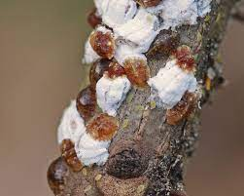
Scale – common.

Slide 17
Most of you would be familiar – if not all of you – with the more common forms of scale. Some of the hard scales can be very hard to eradicate. Many spray with Metho or an oil based insecticide. I am not a fan of oil – hot day – fried orchids! Oils also tend to block the stomata in the leaves – not a good thing.

Slide 18
Once again I normally go for systemic insecticides – one spray to get the lot – your treatment may be different. I do not have time to spray over and under leaves to get rid of scale – and down into left over, dead parts of leaves and new growths. I work for myself and even weekends are largely taken up keeping the tax man off my back – paper work.

Slide 19
As a general spray I find Bifenthrin, Permethrin or Deltamethrin (same thing - synthetic pyrethroid) for the following pests. It gets spayed over all the orchids, shade house floor, walls, roof, benches. Fleas Flies Midges Cockroaches Termites Grasshoppers Spiders

Slide 20
Beetles Fire ants Ants Worms Gnats Moths Earwigs Mites Thrips Ticks

Slide 21
Maggots Mosquitoes In fact effective on over 75 types of insects. You can even buy similar in Woolworths and Coles. Mortein PowerGard is deltamethrin – a synthetic pyrethrum.

Slide 22
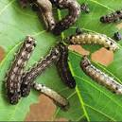
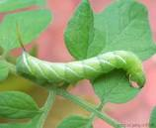
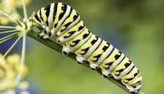
Caterpillars.
Oh what a mess they make of your plants in a very short space of time.
Spray with Carbaryl Or Dipel - Carbaryl has a residual effect, Dipel is a very good Eco friendly product that affects the caterpillar’s stomach and stops it eating.

Slide 23
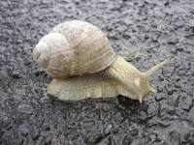
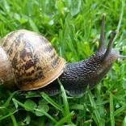
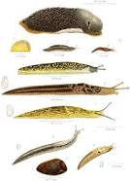
Snails And Slugs
Snails And Slugs
The devil in disguise! Many use Eco friendly methods such as beer in a container so they drown. I have had very limited success with this method at all.

Slide 24
In fact the best results I have had is to bust up the Bayer snail and slug bait in a coffee grinder and sprinkle on the pots. Problem is it goes moldy. A friend of mine uses Metakill and claims good results. If you can obtain Mesurol it can be sprayed several times a year right through the shade house but I am not sure if it is still available.

Slide 25
Bees And Bugs For Bugs I have not tried Bugs For Bugs and wonder what happens to them when the food source gets cleaned up. I often hear people telling everyone to not use insecticides as they will kill bees. While that is true the question is when do bees come around orchids to be exposed. Only when they are in flower – the bees come after the pollen.

Slide 26
Additionally much of the research on bees and insecticides has been done in Europe where the bee population is diseased. We have a very robust and healthy bee population in Australia and when one considers what the farmers use in the way of insecticides it makes one wonder how accurate and relevant the European research really is with respect to Australia. I believe that insecticides will not be a problem to bees unless the orchids are in flower. Just isolate the flowering orchids?

Slide 27
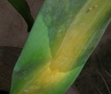
Bacterial Infections. Soft and brown rot (Erwinia)
Remove the infected tissue with a sterile instrument. Remove the plant from the pot and soak the whole plant in a bactericide containing quaternary ammonium. Hy Chlor swimming pool algaecide is suitable from Bunnings.
15 mls per 4 litres of water.

Slide 28
Brown Spot (Pseudomonas)
Remove the infected tissue with a sterile instrument. Remove the plant from the pot and soak the whole plant in a bactericide containing quaternary ammonium. Hy Chlor swimming pool algaecide is suitable from Bunnings.
15 mls per 4 litres of water.

Slide 29
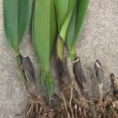
Black Rot (Pythium And Phytophthora)
Discard the plant – this is highly infectious and is spread by splashing water. If it is a valuable plant isolate it. Remove the infected tissue with a sterile instrument. Drench the whole pot in a fungicide such and Rid-A-Rot (phosphoric acid based fungicide) as per the label. Keep dry for a week and drench again.

Slide 30
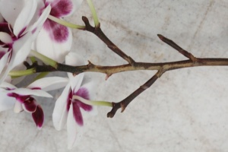
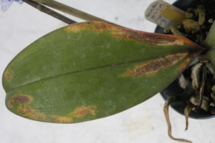
Fusarium Wilt.
Discard the plant.
If you must try and save your Cattleya remove the infected rhizome with a sterile instrument. Cut back until the purple ring has been cleared.
Drench with a fungicide containing
Thiophanate-methyl (dimethyl 4,4'-o-phenylenebis[3-thioallophanat)

Slide 31
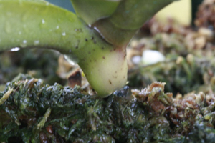
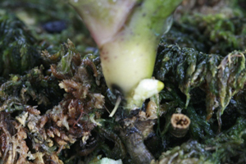
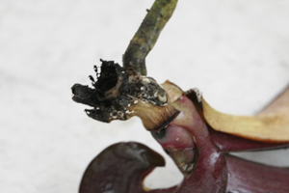
Collar Rot, Southern Blight - Sclertium.
Remove the infected parts of roots and leaves with a sterile instrument.
Drench the whole plant in Medallion Fungicide.

Slide 32
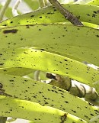
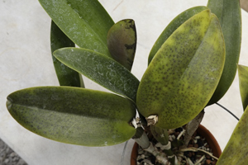
Leaf Spots.
There are a whole range of these with fancy names.
Daconil is a good fungicide to use for them.

Slide 33
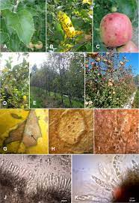
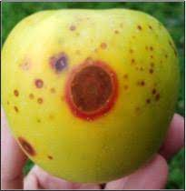
Glomerella (Sydney Rots).
I was unable to find a photo of the typical effects of Glomerella with, particularly, Cymbidiums.
Basically the new growth just rots out.
Treatment is drench the whole pot and plant in a phosphoric acid based fungicide – keep dry for 14 days – repeat.

Slide 34
Fungal problems can be deterred to a degree by a implementing a proper spraying regime. Preventative spraying. I find Mancozeb is very good for this but not a lot of good as a spray to cure fungal problems – has never done much for me. Phosphoric acid based fungicides are also useful as a preventative but also useful as a cure as noted previously. The fungicides I have mentioned are all available in Australia.

Slide 35
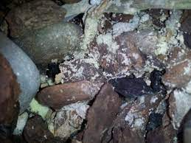
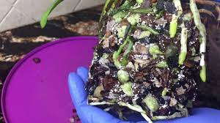
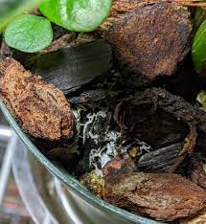
Snow Mold.
This is a horrible mold. It grows in the mix and eventually covers the roots and stops the plant taking up water thus it dies.
Take the orchid out of the mix, soak in a good fungicide for an hour then re-pot in fresh mix.

Slide 36
There have been a few theories about what causes snow mold over the years. The most popular one appears to be rotting wood in the mix – take all wood out of your bark. Another popular one is bark breaking down causes it. I am of the view it is more complex than that but do not have an answer. I had 10 orchids all in a row – all Avril’s Gold – all in the same pots – all in the same mix – all watered and fertilized the same – same light. One went backwards. Took it out of the pot – snow mold. Checked the others and they were all clean. It only developed in one pot out of ten.

Slide 37
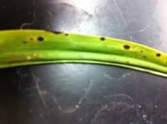
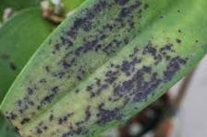
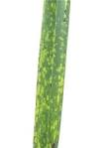
Virus. Cymbidium Mosaic Virus.
.
This is one of the viruses we commonly see in orchids.

Slide 38
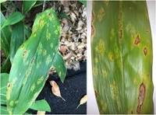
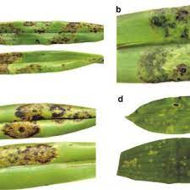
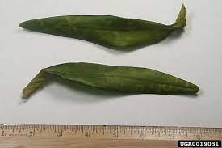
Orchid Fleck Virus.
.
This is one of the viruses we commonly see in orchids.

Slide 39
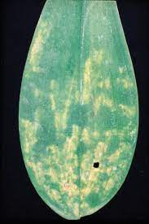
Odontoglossum Ringspot Virus.
.
This is one of the viruses we commonly see in orchids.

Slide 40
Typical virused Cattleya Flowers.
.
Often it is only colour break that can indicate that an orchid is virused – not only Cattleya either.

Slide 41
There are over thirty five viruses that can affect orchids. Currently tests are available for only two viruses. The remainder have to be detected under a microscope. If an orchid is particularly valuable or rare it may be worth sending off to be examined but it is very expensive. Even orchid test kits for two viruses are not cheap. If I even suspect an orchid has a virus it is destroyed – Roundup does the job. There is NO cure – do not let any one tell you that there is a cure.
.

